Slide 1

Project Procrastination
Software architecture

Slide 2

Project Procrastination
Our app was developed using android studio in the programming language Kotlin. This app was developed with the intention of eliminating procrastination tendencies in students. The functionality includes a calendar where students can save important events and deadlines while also having a flashcards tool. Students can easily date when a flashcard set must be studied in the calendar.

Slide 3
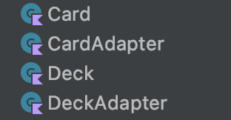
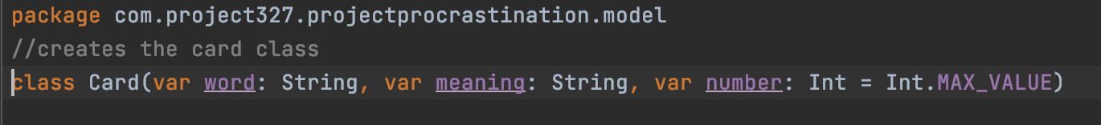
This code, located in the model folder, creates a class named card. It initializes each card created and gives it a title, a definition, and a position. Every time a card is created, it will be using this class. Other classes shown later in the code will be used to edit the flashcards.

Slide 4
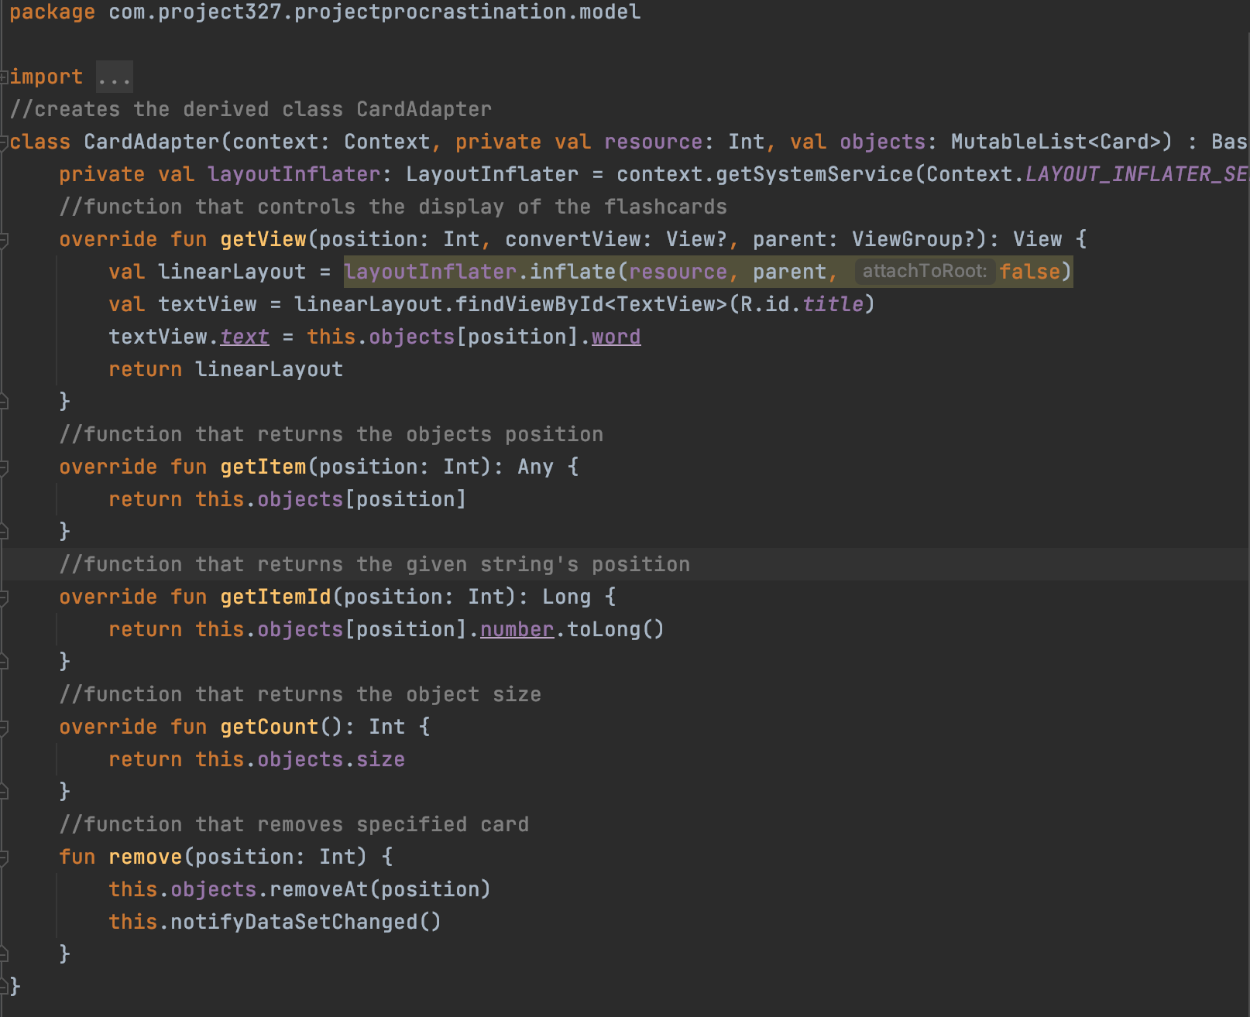
This code, located in the model folder, creates a class named CardAdapter. This class allows the flashcards to be edited. For example, it allows for the user to edit the text, delete a card, add a card, and add multiple cards at once. It includes the functions getView(), getItem(), getItemId(), getCount(), and remove().

Slide 5
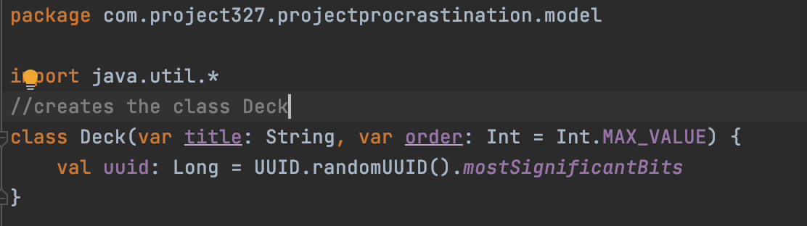
This code, located in the model folder, creates a class named Deck. It initializes each deck created and gives it a title, an order , and a maximum value of cards located in the deck. Whenever a deck is first created it is using this class. To edit decks, there is another class that will be explained next.

Slide 6
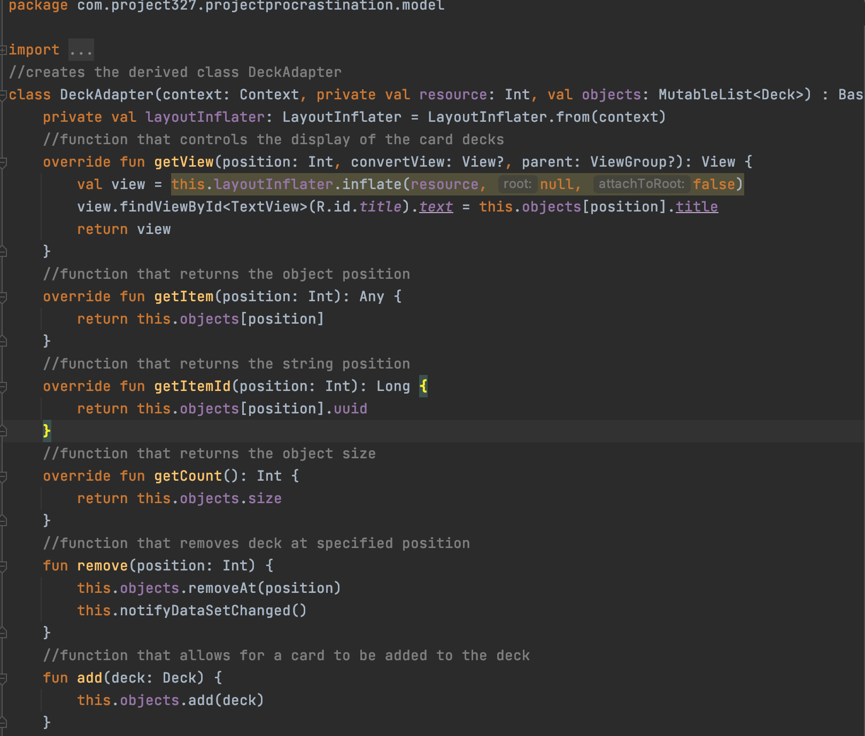
This code, located in the model folder, creates a class named DeckAdapter. This class allows the decks to be edited. For example, it allows for the user to rename the decks, delete a deck, and add a deck. It includes the functions getView(), getItem(), getItemId(), getCount(), remove(), and add().

Slide 7
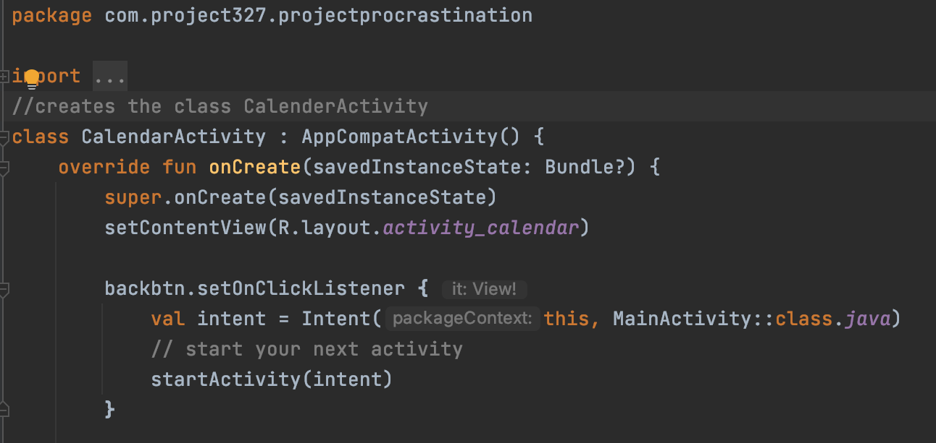
This file named “CalendarActivity.kt” initializes the calendar and how the layout will be presented to the user. This code defines a class named CalendarActivity. It specifically creates a back button so the user can return to the main screen.

Slide 8
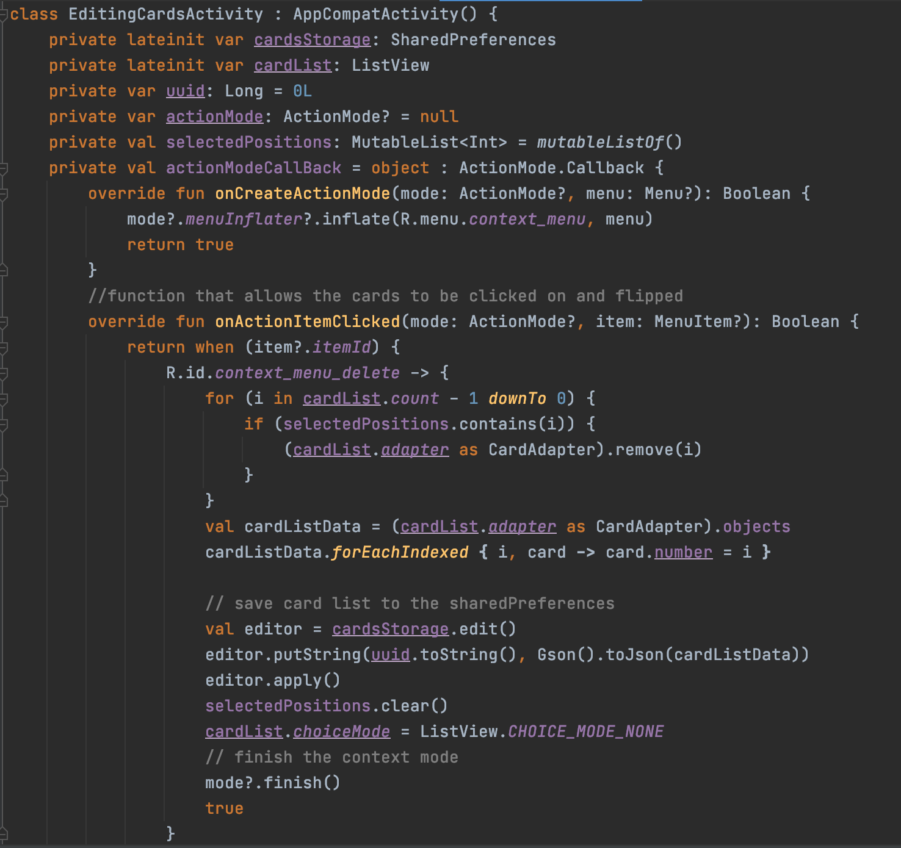
This code, located in the java folder, creates a class named EditingCardsActivity. This class calls the CardAdapter class in order to use the functions. The EditingCardsActivity is how the code is displayed to the user. It allows the user to see the edits they are making in real-time.

Slide 9
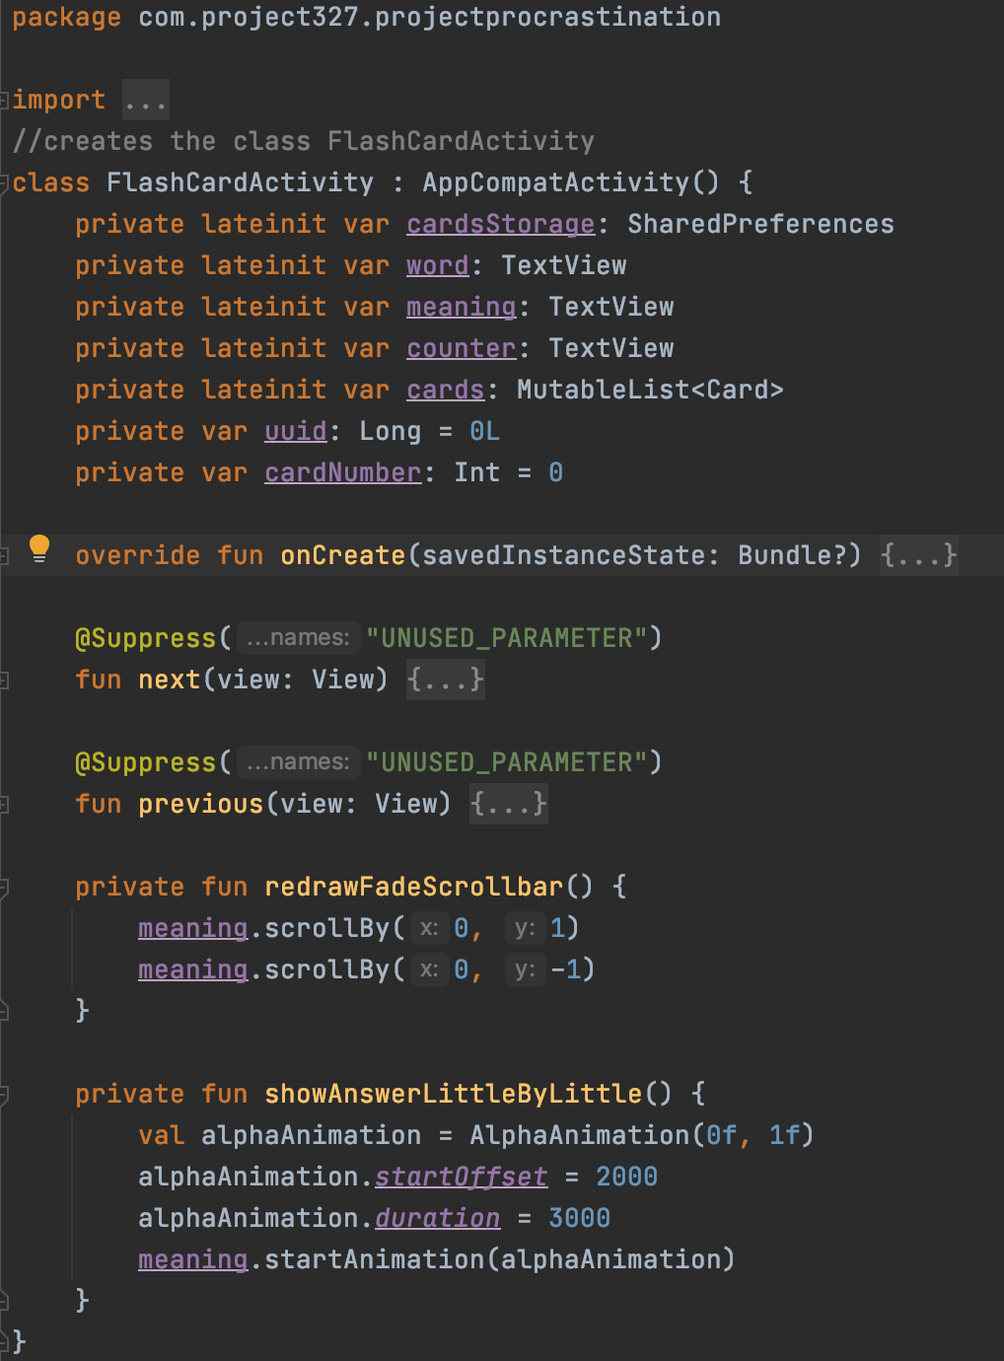
This code, located in the java folder, creates a class named FlashCardActivity. This class calls the DeckAdapter class in order to use the functions. The FlashCardActivity is how the code is displayed to the user. There is a function that waits a few seconds to show the answer called showAnswerLittleByLittle() and a function that allows the user to scroll through the flashcards called redrawFadeScrollbar().

Slide 10
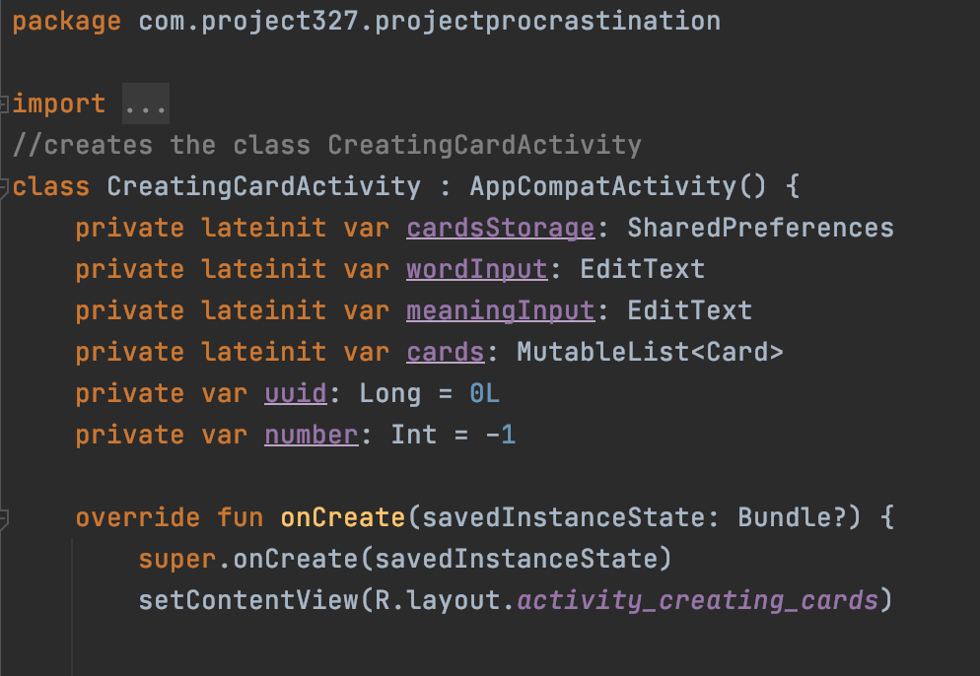
This class named CreatingCardActivity allows the user to create the flashcard, add text to it, and add a definition.

Slide 11
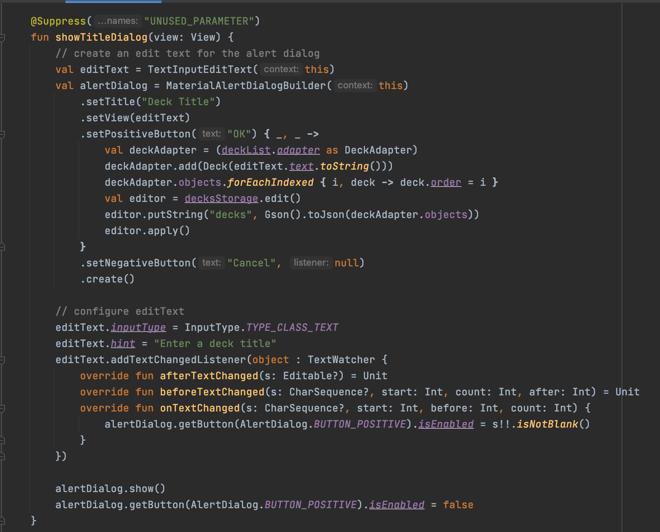
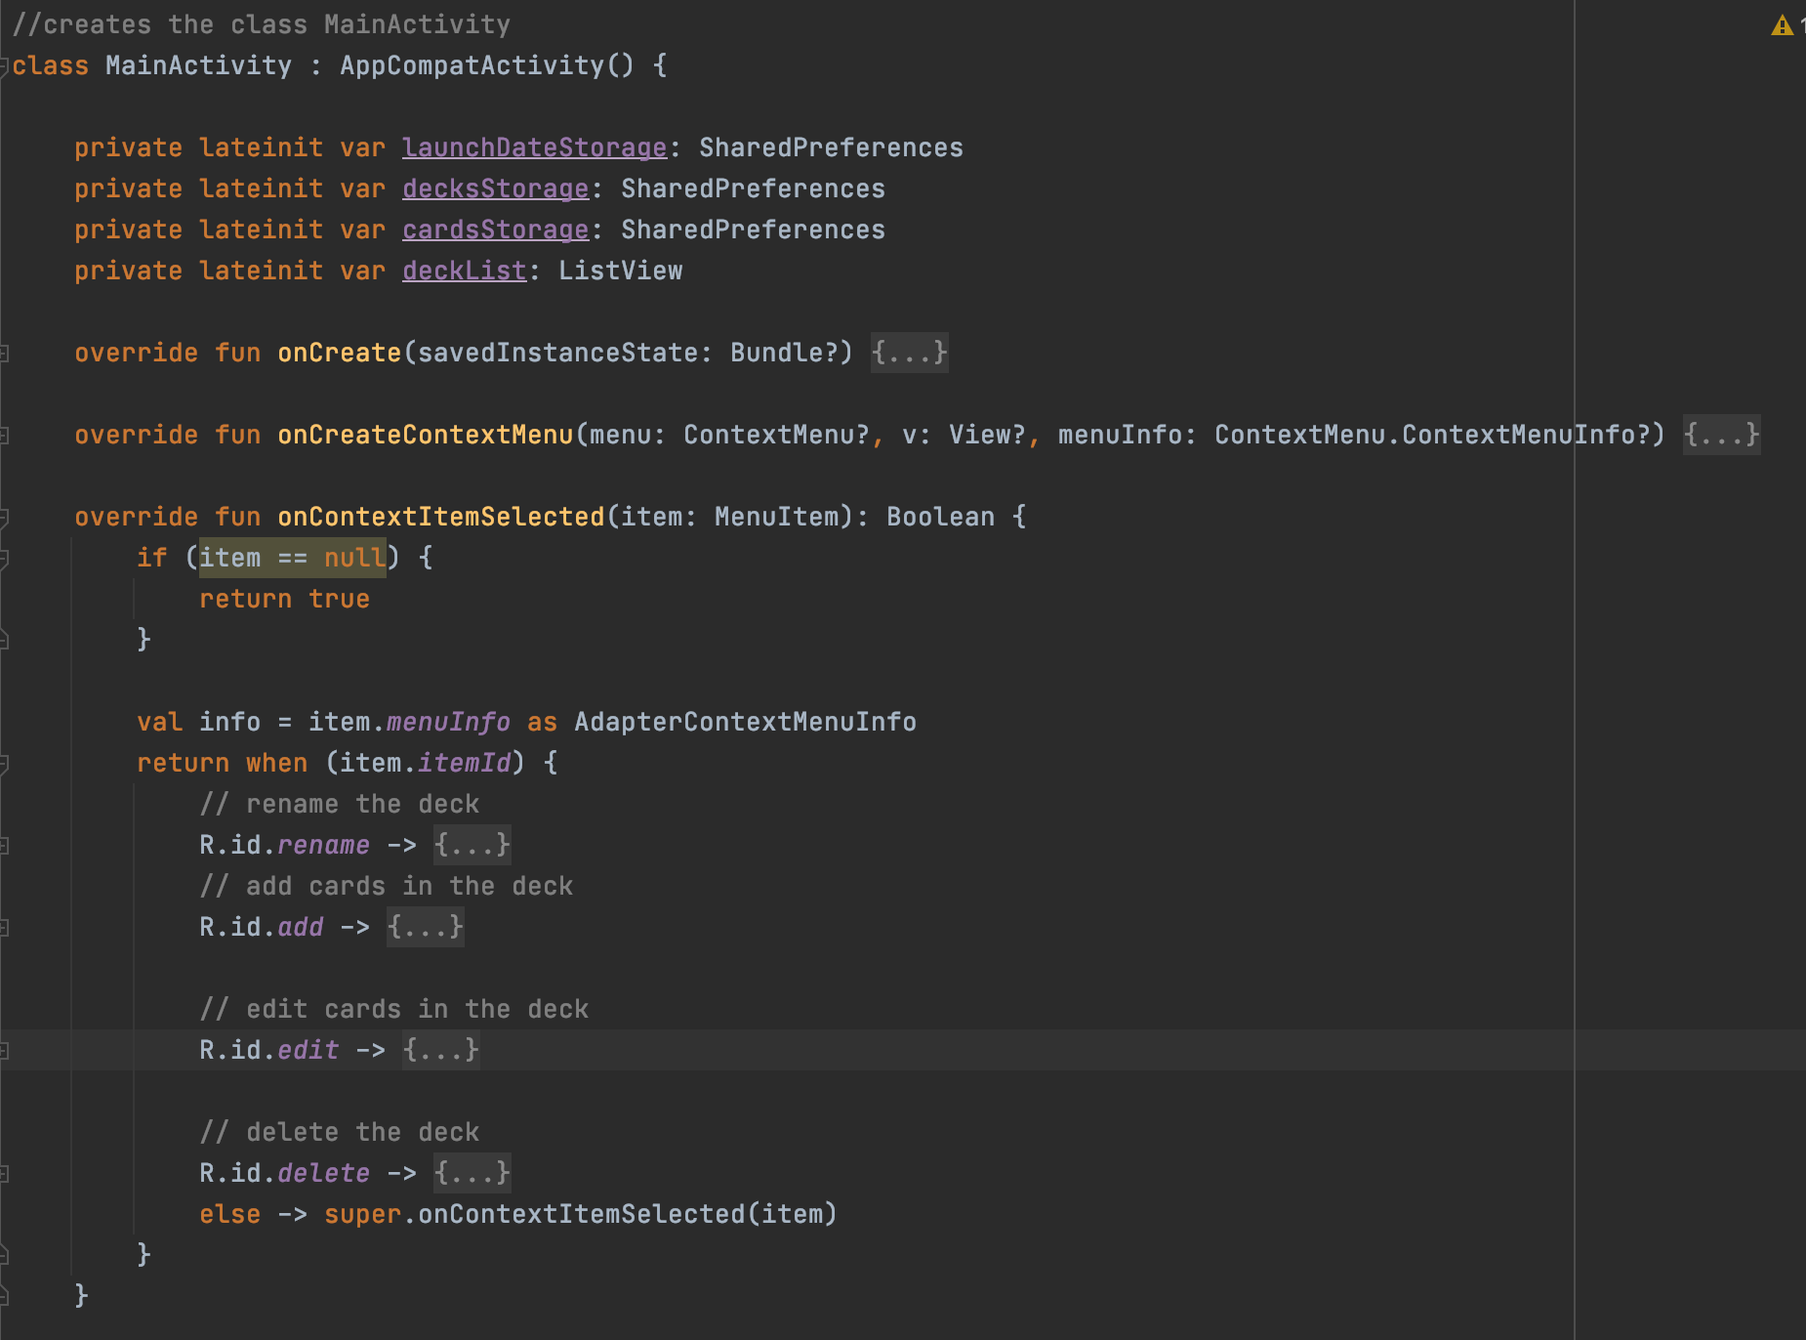
This code, located in the java folder, creates a class named MainActivity. This class calls the DeckAdapter class in order to use the functions.
This code is for the user interface. It is how the flashcard app, and the calendar app will be displayed to the user. It creates the buttons that allow the user to interact with the app.

Slide 12
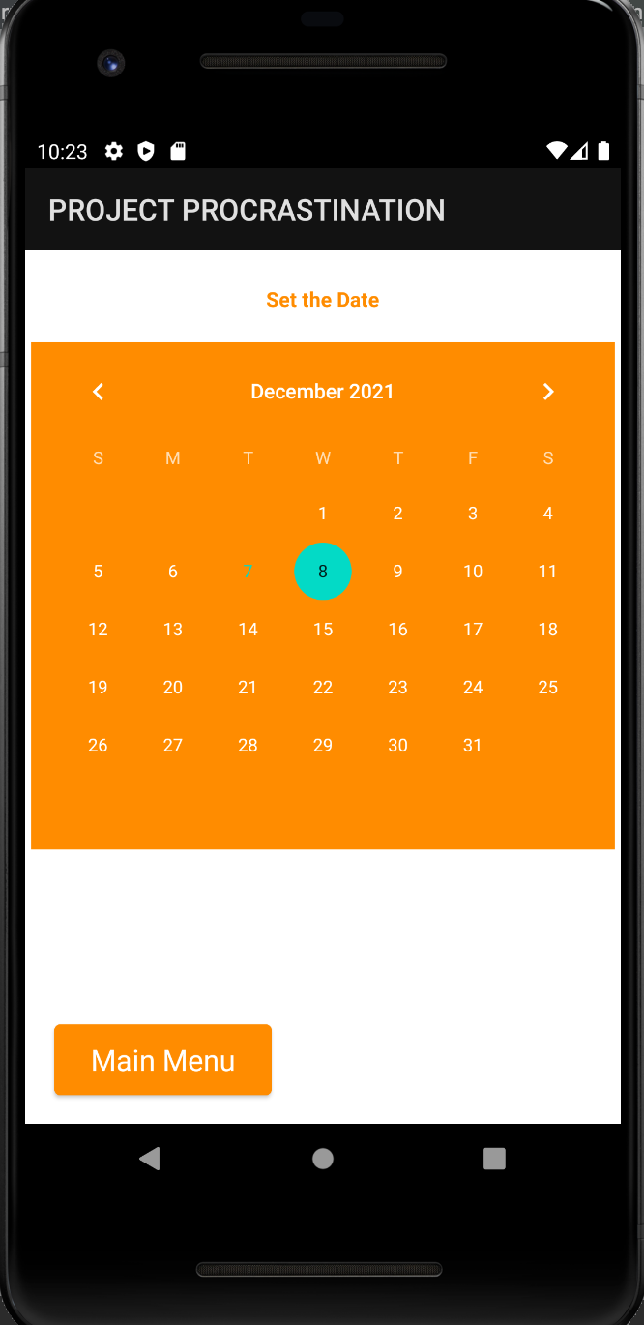
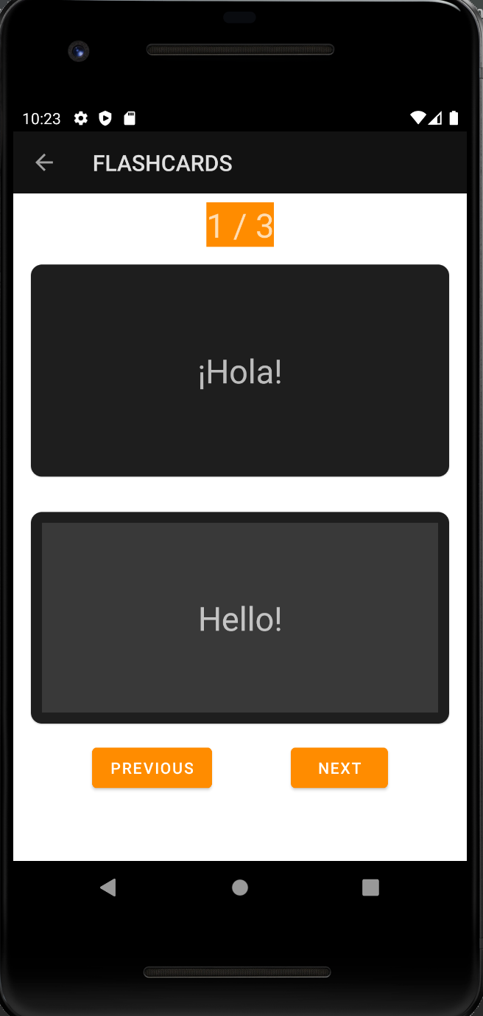
Example of the user interface for the calendar app:
Example of the user interface for the flashcard app:

Slide 13
Thank You
Project procrastination Was Created and designed by: Leon Long, leanorine lorenzana, Hassan Hijazi, Angelo orciuoli, and marybel boujaoude

